Slide 1
Modern Systems Analysis and Design Sixth Edition Jeffrey A. Hoffer Joey F. George Joseph S. Valacich
Chapter 6
Determining System Requirements

Slide 2
Learning Objectives
Describe options for designing and conducting interviews and develop a plan for conducting an interview to determine system requirements.
Explain the advantages and pitfalls of observing workers and analyzing business documents to determine system requirements.

Slide 3
Learning Objectives (Cont.)
Explain how computing can provide support for requirements determination.
Participate in and help plan a Joint Application Design session.
Use prototyping during requirements determination.
Describe contemporary approaches to requirements determination.
Understand how requirements determination techniques apply to the development of electronic commerce applications.

Slide 4
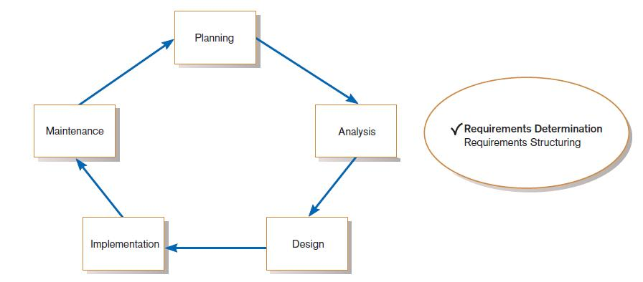
Performing Requirements Determination
FIGURE 6-1
Systems development life cycle with analysis phase highlighted

Slide 5
The Process of Determining Requirements
Good Systems Analyst Characteristics:
Impertinence—question everything
Impartiality—consider all issues to find the best organizational solution
Relaxing constraints—assume anything is possible
Attention to details—every fact must fit
Reframing—challenge yourself to new ways

Slide 6
Deliverables and Outcomes
Deliverables for Requirements Determination:
From interviews and observations — interview transcripts, observation notes, meeting minutes
From existing written documents — mission and strategy statements, business forms, procedure manuals, job descriptions, training manuals, system documentation, flowcharts

Slide 7
Deliverables and Outcomes (Cont.)
From computerized sources — Joint Application Design session results, CASE repositories, reports from existing systems, displays and reports from system prototype

Slide 8
Methods for Determining System Requirements
Traditional Methods
Contemporary Methods
Radical Methods
Agile Methodologies

Slide 9
1- Traditional Methods for Determining Requirements
Interviewing
individuals
groups
Observing workers
Studying business documents

Slide 10
1.1- Interviewing and Listening
One of the primary ways analysts gather information about an information systems project
Interview Guide is a document for developing, planning and conducting an interview.

Slide 11
Guidelines for Effective Interviewing
Plan the interview.
Prepare interviewee: appointment, priming questions.
Prepare agenda, checklist, questions.
Listen carefully and take notes (tape record if permitted).
Review notes within 48 hours.
Be neutral.
Seek diverse views.

Slide 12
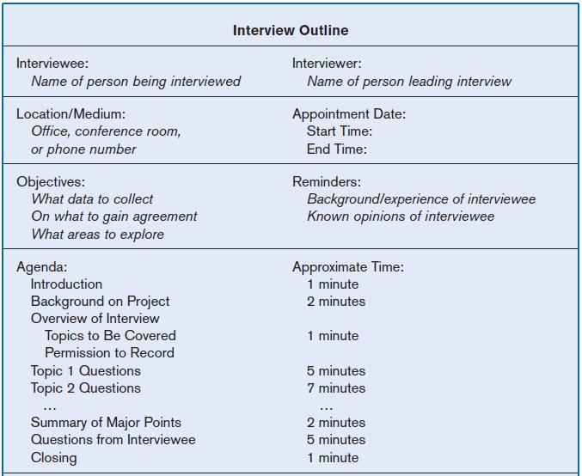
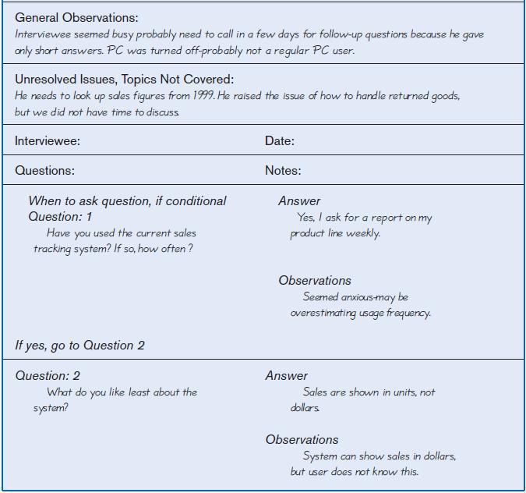
Interviewing and Listening (Cont.)
FIGURE 6-2 Typical interview guide

Slide 13
Choosing Interview Questions
Each question in an interview guide can include both verbal and non-verbal information.
Open-ended questions: questions that have no pre-specified answers
Closed-ended questions: questions that ask those responding to choose from among a set of specified responses

Slide 14
1.2- Interviewing Groups
Drawbacks to individual interviews:
Contradictions and inconsistencies between interviewees
Follow-up discussions are time consuming
New interviews may reveal new questions that require additional interviews with those interviewed earlier

Slide 15
Interviewing Groups (Cont.)
Interviewing several key people together
Advantages
More effective use of time
Can hear agreements and disagreements at once
Opportunity for synergies
Disadvantages
More difficult to schedule than individual interviews

Slide 16
Nominal Group Technique (NGT)
A facilitated process that supports idea generation by groups
Process
Members come together as a group, but initially work separately.
Each person writes ideas.
Facilitator reads ideas out loud, and they are written on a blackboard or flipchart.

Slide 17
Nominal Group Technique (NGT)
Group openly discusses the ideas for clarification.
Ideas are prioritized, combined, selected, reduced.
NGT exercise used to complement group meetings or as part of JAD effort.

Slide 18
1.3- Directly Observing Users
Direct Observation
Watching users do their jobs
Obtaining objective measures of employee interaction with information systems
Can cause people to change their normal operating behavior
Time-consuming and limited time to observe

Slide 19
1.4- Analyzing Procedures and Other Documents
Document Analysis
Review of existing business documents
Can give a historical and “formal” view of system requirements
Types of Documents
Written work procedure
Business form
Report
Description of current information system

Slide 20
Analyzing Procedures and Other Documents (Cont.)
Types of information to be discovered:
Problems with existing system
Opportunity to meet new need
Organizational direction
Names of key individuals
Values of organization
Special information processing circumstances
Reasons for current system design
Rules for processing data

Slide 21
Analyzing Procedures and Other Documents (Cont.)
Useful document: Written work procedure
For an individual or work group
Describes how a particular job or task is performed
Includes data and information used and created in the process

Slide 22
Analyzing Procedures and Other Documents (Cont.)
Potential Problems with Procedure Documents:
May involve duplication of effort.
May have missing procedures.
May be out of date.
May contradict information obtained through interviews.

Slide 23
Analyzing Procedures and Other Documents (Cont.)
Formal Systems: the official way a system works as described in organizational documentation (i.e. work procedure)
Informal Systems: the way a system actually works (i.e. interviews, observations)

Slide 24
Analyzing Procedures and Other Documents (Cont.)
Useful document: Business form
Used for all types of business functions
Explicitly indicate what data flow in and out of a system and data necessary for the system to function
Gives crucial information about the nature of the organization

Slide 25
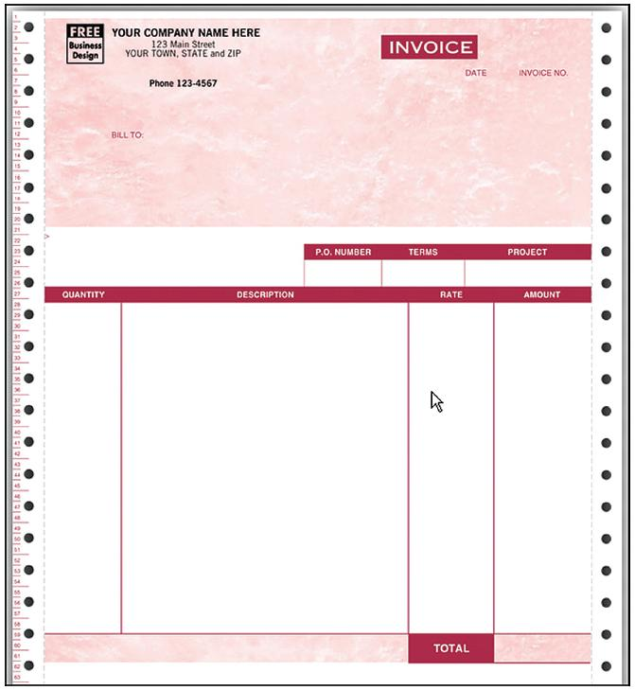
Analyzing Procedures and Other Documents (Cont.)
FIGURE 6-4
An example of a business form—An invoice form for QuickBooks, from jnk.btobsource.com. Reprinted by permission.
Source: http://jnk.btobsource.com/
NASApp/enduser/products/product_
detail.jsp?pc513050M#

Slide 26
Analyzing Procedures and Other Documents (Cont.)
Useful document: Report
Primary output of current system
Enables you to work backwards from the report to the data needed to generate it
Useful document: Description of current information system

Slide 27
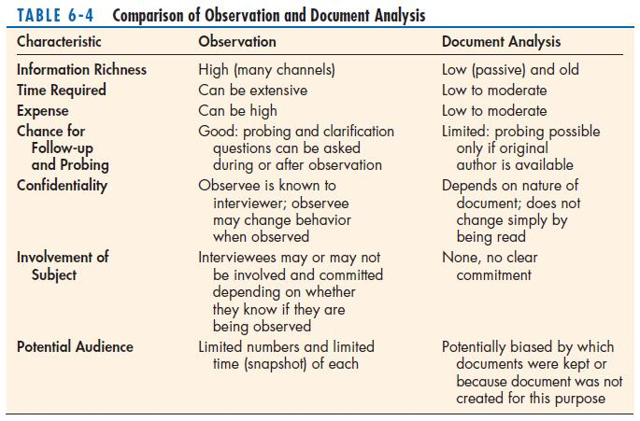
Analyzing Procedures and Other Documents (Cont.)

Slide 28
2- Contemporary Methods for Determining System Requirements
Joint Application Design (JAD)
Brings together key users, managers, and systems analysts
Purpose: collect system requirements simultaneously from key people
Conducted off-site
Group Support Systems
Facilitate sharing of ideas and voicing of opinions about system requirements

Slide 29
Contemporary Methods for Determining System Requirements (Cont.)
CASE tools
Used to analyze existing systems
Help discover requirements to meet changing business conditions
System prototypes
Iterative development process
primary working version of system
Refine understanding of system requirements in concrete terms

Slide 30
2.1- Joint Application Design (JAD)
Intensive group-oriented requirements determination technique
Team members meet in isolation for an extended period of time
Highly focused
Resource intensive
Started by IBM in 1970s

Slide 31
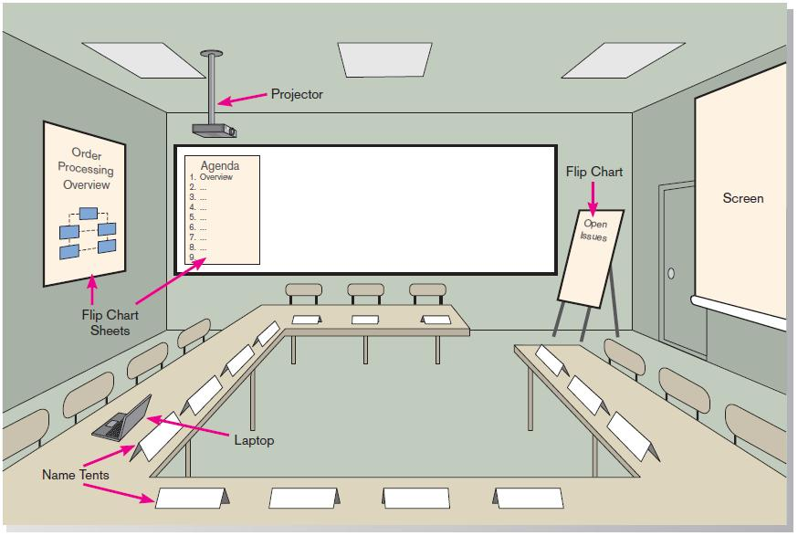
JAD (Cont.)
FIGURE 6-6 Illustration of the typical room layout for a JAD
Source: Based on Wood and Silver, 1995

Slide 32
JAD (Cont.)
JAD Participants:
Session Leader: facilitates group process
Users: active, speaking participants
Managers: active, speaking participants
Sponsor: high-level champion, limited participation
Systems Analysts: should mostly listen
Scribe: record session activities
IS Staff: should mostly listen

Slide 33
JAD (Cont.)
End Result
Documentation detailing existing system
Features of proposed system

Slide 34
2.2- CASE Tools During JAD
Enables analysts to enter system models directly into CASE during the JAD session
Screen designs and prototyping can be done during JAD and shown to users

Slide 35
2.3- Using Prototyping During Requirements Determination
Quickly converts requirements to working version of system
Once the user sees requirements converted to system, will ask for modifications or will generate additional requests

Slide 36
Using Prototyping During Requirements Determination (Cont.)
Most useful when:
User requests are not clear.
Few users are involved in the system.
Designs are complex and require concrete form.
There is a history of communication problems between analysts and users.
Tools are readily available to build prototype.

Slide 37
Using Prototyping During Requirements Determination (Cont.)
Drawbacks
Tendency to avoid formal documentation
Difficult to adapt to more general user audience
Sharing data with other systems is often not considered
Systems Development Life Cycle (SDLC) checks are often bypassed

Slide 38
3- Radical Methods for Determining System Requirements
Business Process Reengineering (BPR):
search for and implementation of radical change in business processes to achieve breakthrough improvements in products and services

Slide 39
Radical Methods for Determining System Requirements (Cont.)
Goals
Reorganize complete flow of data in major sections of an organization.
Eliminate unnecessary steps.
Combine steps.
Become more responsive to future change.

Slide 40
Identifying Processes to Reengineer
Key business processes
Structured, measured set of activities designed to produce specific output for a particular customer or market
Focused on customers and outcome
Same techniques are used as for requirements determination

Slide 41
Disruptive Technologies
Information technologies must be applied to radically improve business processes.
Disruptive technologies are technologies that enable the breaking of long-held business rules that inhibit organizations from making radical business changes.

Slide 42
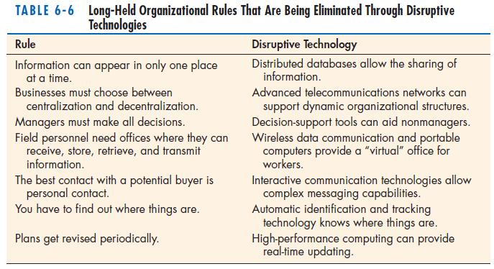
Disruptive Technologies (Cont.)

Slide 43
Requirements Determination using Agile Methodologies
Continual user involvement
Replace traditional SDLC waterfall with iterative analyze – design – code – test cycle
Agile usage-centered design
Focuses on user goals, roles, and tasks
The Planning Game
Based on eXtreme programming
Exploration, steering, commitment

Slide 44
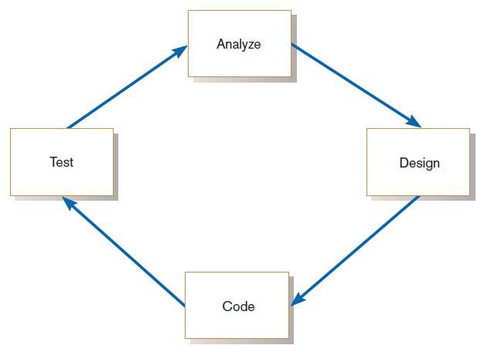
Continual User Involvement
FIGURE 6-11
The iterative analysis–design–code–test cycle

Slide 45
Agile Usage-Centered Design Steps
Gather group of programmers, analysts, users, testers, facilitator.
Document complaints of current system.
Determine important user roles.
Determine, prioritize, and describe tasks for each user role.
Group similar tasks into interaction contexts.
Associate each interaction context with a user interface for the system, and prototype the interaction context.
Step through and modify the prototype.

Slide 46
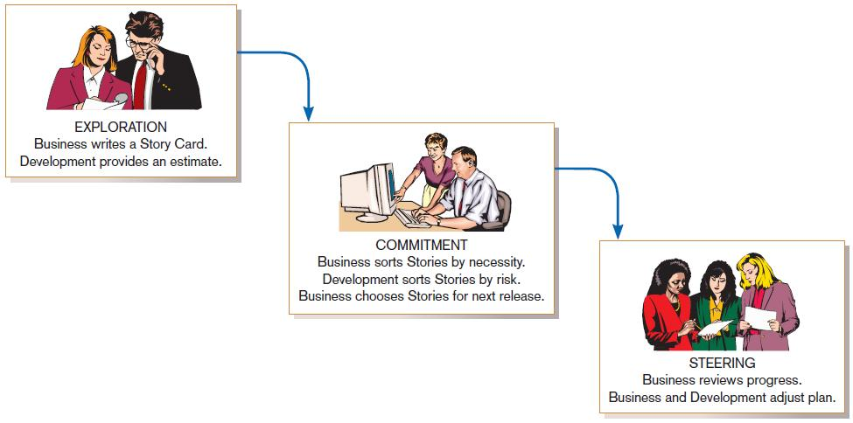
The Planning Game from eXtreme Programming
FIGURE 6-12
eXtreme Programming’s Planning Game

Slide 47
Thanks

